Slide 1
Capstone Engagement
Assessment, Analysis, and Hardening of a Vulnerable System

Slide 2
Table of Contents
This document contains the following sections:
01
Network Topology
02
Red Team: Security Assessment
03
Blue Team: Log Analysis and Attack Characterization
Hardening: Proposed Alarms and Mitigation Strategies
04

Slide 3
Network Topology
3

Slide 4
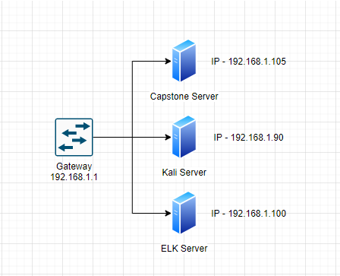
Network Topology
Network
Address Range:192.168.1.0/24
Netmask: 24
Gateway:192.168.1.1
Machines
IPv4: 192.168.1.1
OS: Windows
Hostname: NAT Switch
IPv4: 192.168.1.105
OS: Linux
Hostname:
IPv4: 192.168.1.90
OS: Linux
Hostname: Kali
IPv4: 192.168.1.100
OS: Linux
Hostname: ELK

Slide 5

Red Team
Security Assessment
5

Slide 6
Recon: Describing the Target
Nmap identified the following hosts on the network:
Hostname | IP Address | Role on Network
NAT Switch | 192.168.1.1 | Gateway into the 192.168.1.0/24 network
Capstone | 192.168.1.105 | Capstone server – target for the attack
Kali | 192.168.1.90 | Kali Linux server to run the attacks from
ELK | 192.168.1.100 | ELK server to monitor logs and server performance for devices on the network.

Slide 7
Vulnerability Assessment
The assessment uncovered the following critical vulnerabilities in the target:
Vulnerability | Description | Impact
A05:2021: Security Misconfiguration | The web server allows for directory browsing | This allow the attackers to fish around the web server seeing what is in a directory so they can find attack vectors into the server.
Unauthorized file upload | The web server allows for upload of files through the webdav protocol | This allows attackers to upload arbitraty code to execute on the web server
Remote code execution (RCE) | The web server allows for files uploaded from the above vulnerability to be executed remotely. | This allows for attackers take over the server and control it.

Slide 8
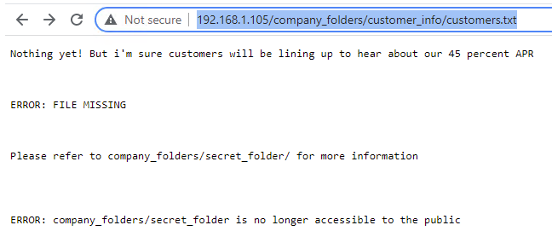
Exploitation: A05:2021: Security Misconfiguration ]
01
02
03
Tools & Processes
Used nmap to find what protocols were running on the target server. Since the server had HTTP enabled, I used a web browser to connect to the server to see what was being hosting on the server. I found that the server still had “Directory Browsing” enabled which allowed me to poke around the hosted web directories.
Achievements
From searching through directories, I found that there was a folder called “secret_folder” under “company_folders” folder.

Slide 9
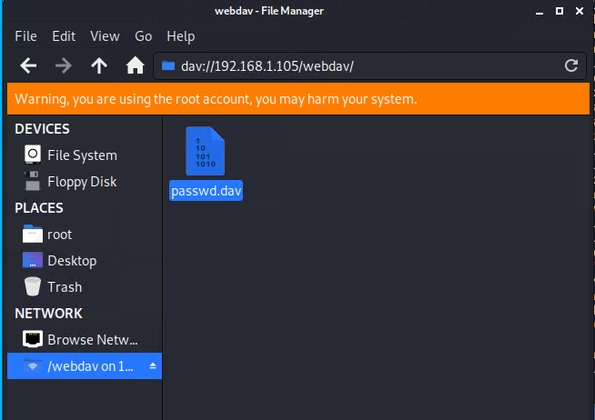
Exploitation: Unauthorized file upload ]
01
02
03
Tools & Processes
Used Hyrda to brute force the admin password for the “secret_folder” directory. From there I found a file (connect_to_corp_server) which had instructions for connecting to the companies webdav server along with a username and hashed password to use. I took the hashed password and ran it through CrackStation.net to get the raw text password.
Achievements
The exploit allowed me to upload files to the web server.

Slide 10
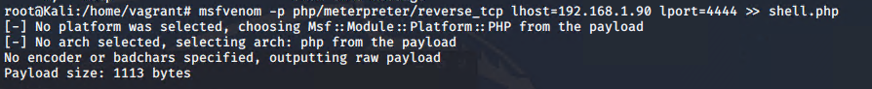
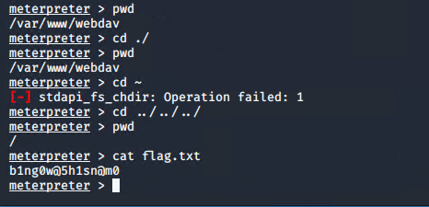
Exploitation: Remote code execution
01
02
03
Tools & Processes
Used MSFVenom to create a reverse shell PHP script that I could upload to the webserver from through the webdav vulnerability found previously. Once the script was uploaded, I ran Metasploits meterpreter listening on the port specified in the PHP script which then allowed me reverse-shell access.
Achievements
This exploit gave me remote access to the server.

Slide 11

Blue Team
Log Analysis and Attack Characterization
11

Slide 12

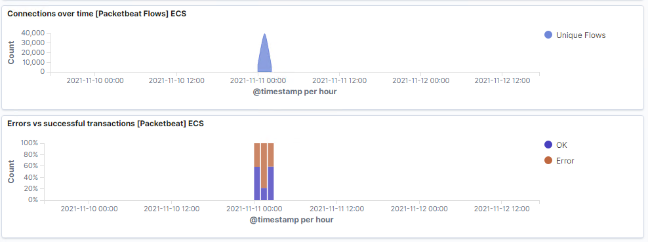
Analysis: Identifying the Port Scan
Answer the following questions in bullet points under the screenshot if space allows. Otherwise, add the answers to speaker notes.
What time did the port scan occur? 2021-11-11 01:00 GMT
How many packets were sent, and from which IP? 39,639
What indicates that this was a port scan? The spike in connections along with the ratio of successful connections vs error connections

Slide 13
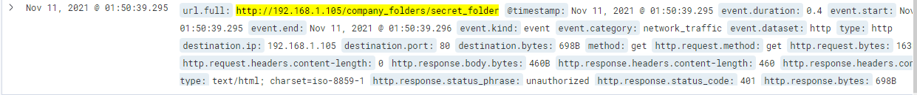
Analysis: Finding the Request for the Hidden Directory
Answer the following questions in bullet points under the screenshot if space allows. Otherwise, add the answers to speaker notes.
What time did the request occur? 2021-11-11 01:50:39
How many requests were made? 15,942
Which files were requested? connect_to_corp
What did they contain? Instructions for connecting to company server

Slide 14
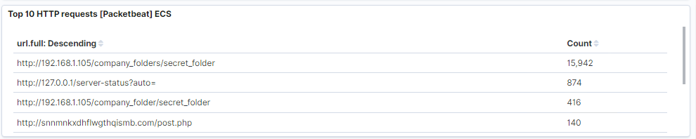
Analysis: Uncovering the Brute Force Attack
Answer the following questions in bullet points under the screenshot if space allows. Otherwise, add the answers to speaker notes.
How many requests were made in the attack? 15,192
How many requests had been made before the attacker discovered the password? 15,191

Slide 15
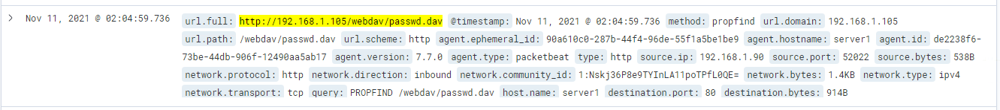
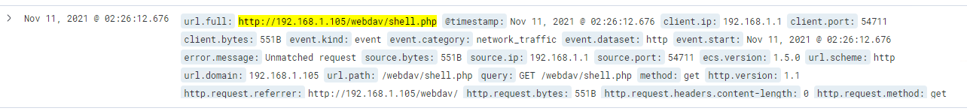
Analysis: Finding the WebDAV Connection
Answer the following questions in bullet points under the screenshot if space allows. Otherwise, add the answers to speaker notes.
How many requests were made to this directory? 41
Which files were requested? passwd.dav , shell.php

Slide 16
Blue Team
Proposed Alarms and Mitigation Strategies
16

Slide 17
Mitigation: Blocking the Port Scan
What kind of alarm can be set to detect future port scans?
Put in a network alert for ICMP pings
What threshold would you set to activate this alarm? More than twenty-five
What configurations can be set on the host to mitigate port scans?
Disable ICMP
Describe the solution. If possible, provide required command lines.

Slide 18
Mitigation: Finding the Request for the Hidden Directory
What kind of alarm can be set to detect future unauthorized access?
Alert on failed login attempts to the directory.
What threshold would you set to activate this alarm?
After five failed login attempts
What configuration can be set on the host to block unwanted access?
Disable directory browsing.
Describe the solution. If possible, provide required command lines.

Slide 19
Mitigation: Preventing Brute Force Attacks
What kind of alarm can be set to detect future brute force attacks? Monitoring of failed login attempts.
What threshold would you set to activate this alarm?
Five failed login attempts
What configuration can be set on the host to block brute force attacks? Only allow five failed login attempts before locking the account.
Describe the solution. If possible, provide the required command line(s).

Slide 20
Mitigation: Detecting the WebDAV Connection
What kind of alarm can be set to detect future access to this directory?
Network watcher for any WebDAV network traffic
What threshold would you set to activate this alarm?
Alert on more than two requests
What configuration can be set on the host to control access?
Disable WebDAV and use something secure
Describe the solution. If possible, provide the required command line(s).

Slide 21
Mitigation: Identifying Reverse Shell Uploads
What kind of alarm can be set to detect future file uploads? Configure a filewatcher on the folder.
What threshold would you set to activate this alarm? When any executable type of file is uploaded.
What configuration can be set on the host to block file uploads? Create a “approved” list of file types that are allowed to be uploaded.
Describe the solution. If possible, provide the required command line.

